Slide 1

FUTURENSE INTERNSHIP
DAY-13
Introduction to SQL Queries
SQL (Structured Query Language) is a powerful language used to manage and manipulate relational databases. It allows users to create, modify, and retrieve data in an efficient and organized manner. This presentation will provide an overview of SQL queries, focusing on the GROUP BY clause and its relationship with the HAVING and WHERE clauses.
NAME: PASAM NUTAN
USN:22BTRAD028
COURSE:CSE(AI&DE)

Slide 2
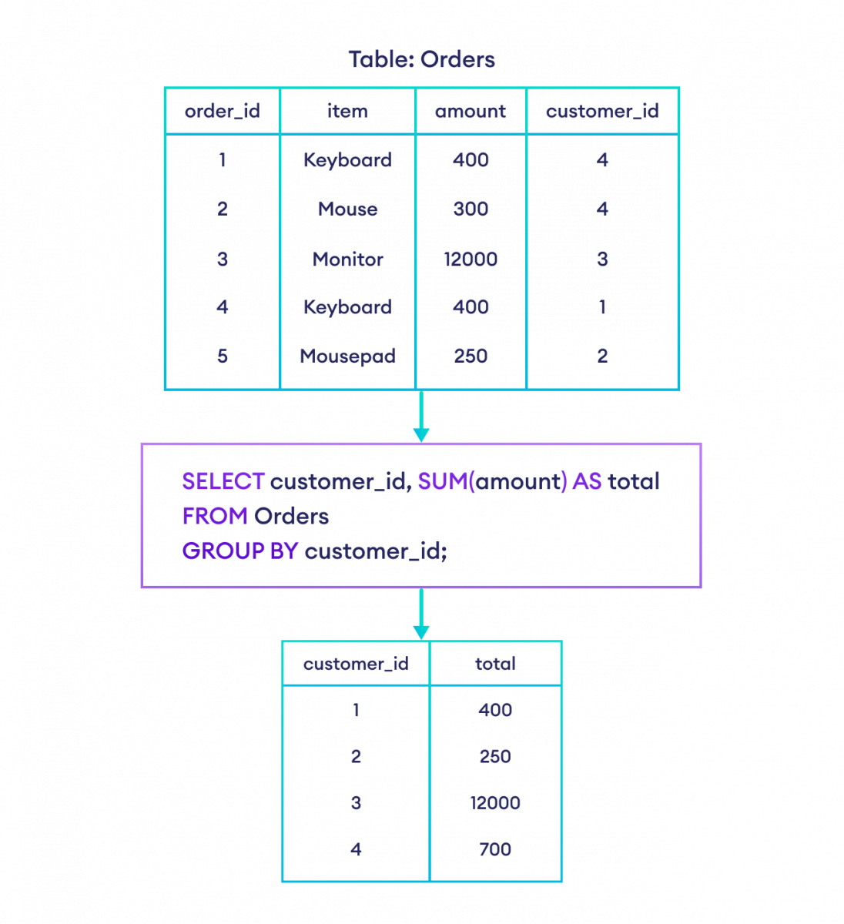
Understanding GROUP BY Clause
1
Grouping Data
The GROUP BY clause is used to group rows that have the same values into summary rows, such as calculating the sum, average, or count of the grouped rows.
2
Aggregate Functions
Aggregate functions, like SUM, AVG, COUNT, MIN, and MAX, are often used in conjunction with the GROUP BY clause to perform calculations on the grouped data.
3
Organizing Results
The GROUP BY clause can be used to organize the results of a query, making it easier to analyze and interpret the data.

Slide 3
Differentiating HAVING and WHERE Clauses
WHERE Clause
HAVING Clause
Comparison
The WHERE clause is used to filter rows based on specific conditions before the aggregation is performed. It is applied to individual rows before the GROUP BY clause.
The HAVING clause is used to filter groups based on specific conditions after the aggregation is performed. It is applied to the groups created by the GROUP BY clause.
The main difference is that WHERE filters individual rows, while HAVING filters the groups created by the GROUP BY clause.

Slide 4
Advantages and Syntax of GROUP BY, HAVING, and WHERE
1
Advantages
2
Syntax for GROUP BY
The GROUP BY, HAVING, and WHERE clauses provide powerful tools for data analysis, allowing users to filter, aggregate, and organize data in complex ways.
SELECT column1, column2, ... aggregateFunction(column) FROM table GROUP BY column1, column2, ...
3
Syntax for HAVING
4
Syntax for WHERE
SELECT column1, column2, ... aggregateFunction(column) FROM table GROUP BY column1, column2, ... HAVING condition;
SELECT column1, column2, ... FROM table WHERE condition GROUP BY column1, column2, ...

Slide 5
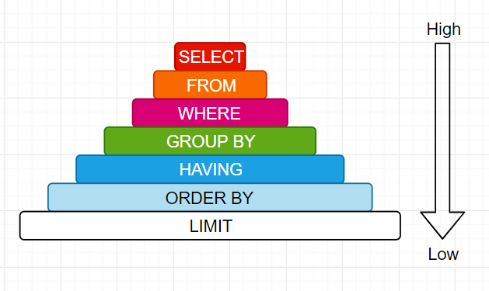
Conclusion and Key Takeaways
In conclusion, this presentation has provided a comprehensive overview of SQL queries, focusing on the GROUP BY, HAVING, and WHERE clauses. By understanding the differences and proper usage of these clauses, you can effectively filter, aggregate, and organize data to gain valuable insights and make informed decisions.
Key takeaways include the role of the GROUP BY clause in grouping data, the use of aggregate functions, the distinction between the HAVING and WHERE clauses, and the specific syntax for each clause. These concepts are essential for mastering SQL and leveraging the full potential of relational databases.

